Slide 1
Statistics

Slide 2
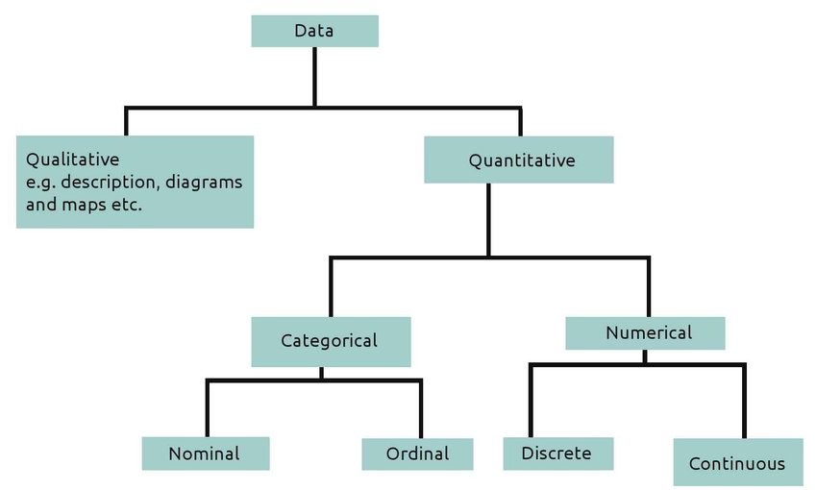
Type of Data

Slide 3
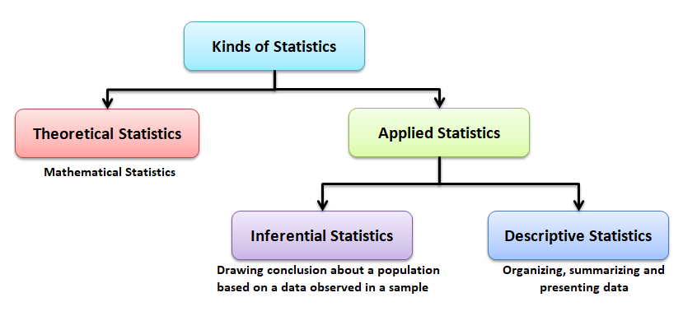
Type of Statistics

Slide 4
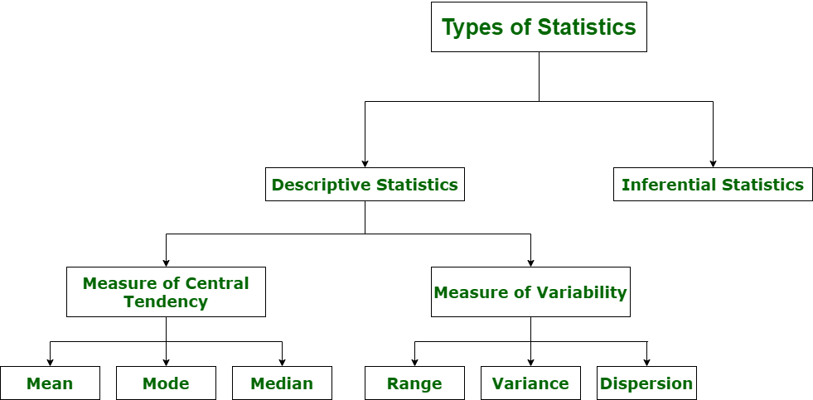
Descriptive Statistics

Slide 5
Measure of Central Tendency
Measure of central tendency is also known as summary statistics that is used to represents the center point or a particular value of a data set or sample set.
Mean : When you think of averaging, you are most likely to think of finding the mean. You add all of the numbers in the set and divide by how many numbers are in the list. For example, suppose you have the numbers 3, 7, 10 and 16. Add them up to get 36. Divide that number by 4 to get the average: 9.
Median : To determine the median, the list of numbers should be arranged in order from lowest to highest. The number in the middle, or the average of the two middle numbers, is the median. For example, if you have the numbers 1, 3, 5 and 7, the middle numbers are 3 and 5, so the median is 4.
Mode : Mode refers to the number in a list that occurs most often. For example, in the group 12, 12, 16, 16, 16, 25 and 36, the number 16 is the mode.

Slide 6
Measure of Variability
A measure of variability is a summary statistic that represents the amount of dispersion in a dataset.
Range: The range of a dataset is the difference between the largest and smallest values in that dataset. For example, in the two datasets below, dataset 1 has a range of 20 – 38 = 18 while dataset 2 has a range of 11 – 52 = 41. Dataset 2 has a broader range and, hence, more variability than dataset 1.
Variance: Variance is the average squared difference of the values from the mean. Unlike the previous measures of variability, the variance includes all values in the calculation by comparing each value to the mean.
SD : The standard deviation is the standard or typical difference between each data point and the mean. When the values in a dataset are grouped closer together, you have a smaller standard deviation. On the other hand, when the values are spread out more, the standard deviation is larger because the standard distance is greater.

Slide 7
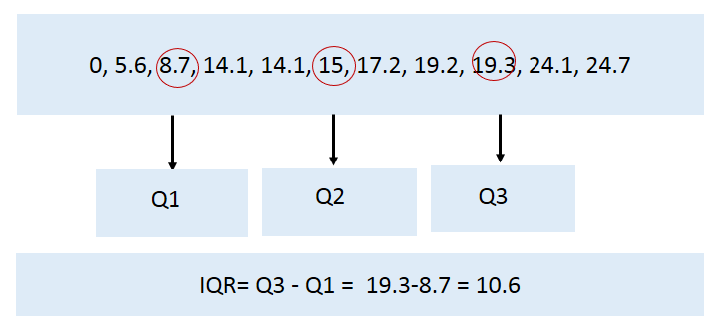
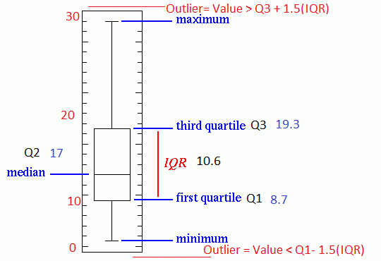
IQR

Slide 8
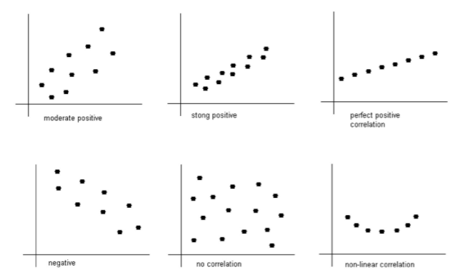
Correlation
When two sets of data are strongly linked together we say they have a High Correlation.
Correlation can have a value:
1 is a perfect positive correlation
0 is no correlation (the values don't seem linked at all)
-1 is a perfect negative correlation

Slide 9
Probability
Example: How many heads when we toss 3 coins?
X = "The number of Heads" is the Random Variable.
In this case, there could be 0 Heads (if all the coins land Tails up), 1 Head, 2 Heads or 3 Heads.
So the Sample Space = {0, 1, 2, 3}
But this time the outcomes are NOT all equally likely.
The three coins can land in eight possible ways:
P(X = 3) = 1/8
P(X = 2) = 3/8
P(X = 1) = 3/8
P(X = 0) = 1/8
Coin1 | Coin2 | Coin3
H | H | H
H | H | T
H | T | H
H | T | T
T | H | H
T | H | T
T | T | H
T | T | T

Slide 10
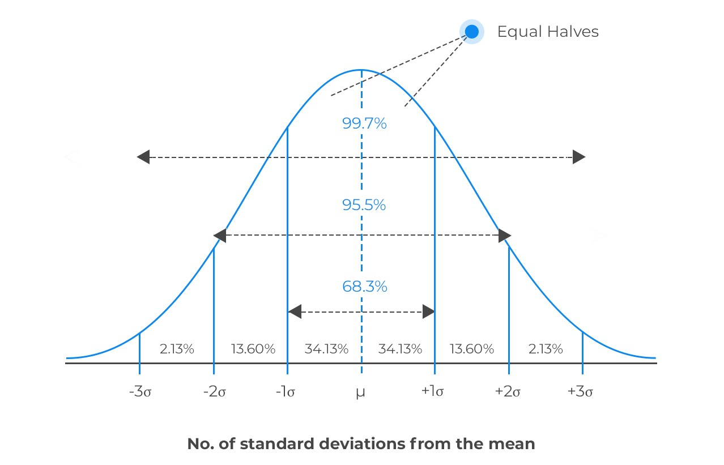
Normal distribution

Slide 11
Central Limit Theorem
The central limit theorem states that if you have a population with mean μ and standard deviation σ and take sufficiently large random samples from the population with replacement, then the distribution of the sample means will be approximately normally distributed. This will hold true regardless of whether the source population is normal or skewed, provided the sample size is sufficiently large (usually n > 30). If the population is normal, then the theorem holds true even for samples smaller than 30.
https://anilz.shinyapps.io/Central_Limit_Theorem/

Slide 12
Inferential Statistics - Sample Size
Example :
We would like to start an ISP and need to estimate the average Internet usage of households in one week for our business plan and model. How many households must we randomly select to be 95 percent sure that the sample mean is within 1 minute of the population mean . Assume that a previous survey of household usage has shown = 6.95 minutes.

Slide 13
Inferential Statistics - Confidence level
Margin of error (confidence interval) :
The margin of error, AKA confidence interval, is expressed in terms of mean numbers. You can set how much difference you’ll allow between the mean number of your sample and the mean number of your population
Confidence level
It deals with how confident you want to be that the actual mean falls within your margin of error. The most common confidence intervals are 90% confident, 95% confident, and 99% confident.

Slide 14

Inferential Statistics - Sample Size
Example :
We would like to start an ISP and need to estimate the average Internet usage of households in one week for our business plan and model. How many households must we randomly select to be 95 percent sure that the sample mean is within 1 minute of the population mean . Assume that a previous survey of household usage has shown = 6.95 minutes.

Slide 15
Inferential Statistics - Sampling Technique
Simple random sampling
In this case each individual is chosen entirely by chance and each member of the population has an equal chance, or probability, of being selected.
Systematic sampling
Individuals are selected at regular intervals from the sampling frame. The intervals are chosen to ensure an adequate sample size.
Stratified sampling
In this method, the population is first divided into subgroups (or strata) who all share a similar characteristic. It is used when we might reasonably expect the measurement of interest to vary between the different subgroups, and we want to ensure representation from all the subgroups.
Clustered sampling
In a clustered sample, subgroups of the population are used as the sampling unit, rather than individuals. The population is divided into subgroups, known as clusters, which are randomly selected to be included in the study.

Slide 16
Hypothesis Testing
What is Hypothesis Testing and why we need it?
Hypothesis testing is an essential procedure in statistics. A hypothesis test evaluates two mutually exclusive statements about a population to determine which statement is best supported by the sample data. When we say that a finding is statistically significant, it’s thanks to a hypothesis test.
Hypothesis testing in statistics is a way for you to test the results of a survey or experiment to see if you have meaningful results. You’re basically testing whether your results are valid by figuring out the odds that your results have happened by chance. If your results may have happened by chance, the experiment won’t be repeatable and so has little use.

Slide 17
Hypothesis Testing
A principal at a certain school claims that the students in his school are above average intelligence. A random sample of thirty students IQ scores have a mean score of 107. Is there sufficient evidence to support the principal’s claim?
The mean population IQ is 100 with a standard deviation of 15.

Slide 18
Hypothesis Testing
A principal at a certain school claims that the students in his school are above average intelligence. A random sample of thirty students IQ scores have a mean score of 107. Is there sufficient evidence to support the principal’s claim?
The mean population IQ is 100 with a standard deviation of 15.
Step 1: State the Null hypothesis.
A null hypothesis is a precise statement about a population that we try to reject with sample data.
H0: μ=100.

Slide 19
Hypothesis Testing
A principal at a certain school claims that the students in his school are above average intelligence. A random sample of thirty students IQ scores have a mean score of 107. Is there sufficient evidence to support the principal’s claim?
The mean population IQ is 100 with a standard deviation of 15.
Step 2: State the alternate hypothesis.
A null hypothesis is a precise statement about a population that we try to reject with sample data.
H1: μ > 100.

Slide 20
Hypothesis Testing
A principal at a certain school claims that the students in his school are above average intelligence. A random sample of thirty students IQ scores have a mean score of 107. Is there sufficient evidence to support the principal’s claim?
The mean population IQ is 100 with a standard deviation of 15.
Step 3: State the alpha level. If you aren’t given an alpha level, use 5% (0.05).
The significance level, also denoted as alpha or α, is the probability of rejecting the null hypothesis when it is true. For example, a significance level of 0.05 indicates a 5% risk of concluding that a difference exists when there is no actual difference.
You can calculate significance level from confidence level

Slide 21
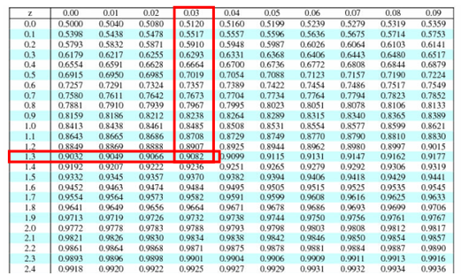
Hypothesis Testing
A principal at a certain school claims that the students in his school are above average intelligence. A random sample of thirty students IQ scores have a mean score of 107. Is there sufficient evidence to support the principal’s claim?
The mean population IQ is 100 with a standard deviation of 15.
Step 4: Find the rejection region area
(given by your alpha level above)
from the z-table if we are going to
perform Z test.
An area of .05 is equal to a
z-score of 1.645.

Slide 22
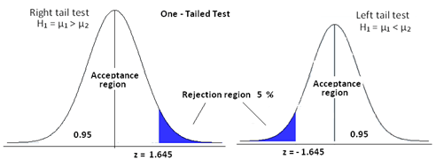
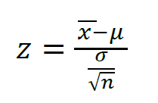
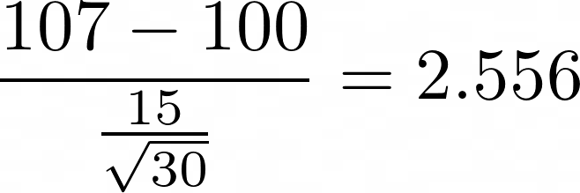
Hypothesis Testing
A principal at a certain school claims that the students in his school are above average intelligence. A random sample of thirty students IQ scores have a mean score of 107. Is there sufficient evidence to support the principal’s claim?
The mean population IQ is 100 with a standard deviation of 15.
Step 5: Find the test statistic using formula:
If Step 5 is greater than Step 4, reject the null hypothesis. In this case, it is greater (2.556 > 1.645), so you can reject the null.

Slide 23
Hypothesis Testing : P-Value
The P value, or calculated probability, is the probability of finding the observed, or more extreme, results when the null hypothesis (H0) of a study question is true
A p value is used in hypothesis testing to help you support or reject the null hypothesis. The p value is the evidence against a null hypothesis. The smaller the p-value, the stronger the evidence that you should reject the null hypothesis.
When you run a hypothesis test, you compare the p value from your test to the alpha level you selected when you ran the test.
A small p (≤ 0.05), reject the null hypothesis. This is strong evidence that the null hypothesis is invalid.
A large p (> 0.05) means the alternate hypothesis is weak, so you do not reject the null.
For Z-score of 2.556 the P-Value is .005.

Slide 24
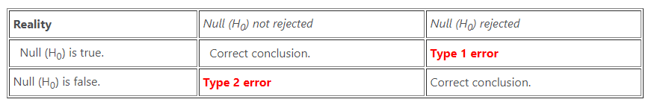
Hypothesis Testing : Types of Error

Slide 25
Hypothesis Testing : Types of Error
Null Hypothesis | Type 1 Error: (H0 true, but rejected ) | Type 2 Error: (H0 False, but not rejected )
Medicine A does not treat Condition B. | Medicine A does not treat Condition B but we reject this and we do not eliminated as a treatment option. | Medicine A relieves Condition B but we say null hypothesis is true and so eliminated Medicine A from treatment option.
Consequences | Patients with Condition B who receive Medicine A get no relief. They may experience worsening condition and/or side effects, up to and including death. | A viable treatment remains unavailable to patients with Condition B may lead to death

